Slide 1
Hair and Fiber Analysis

Slide 2
Hair Analysis

Slide 3
PBS News Hour
http://www.pbs.org/newshour/bb/law/july-dec12/fbi_07-11.html

Slide 4
Characteristics of Hair
Hair is produced by cells within the skin called hair follicles
It becomes non-living as it reaches the skin’s surface

Slide 5
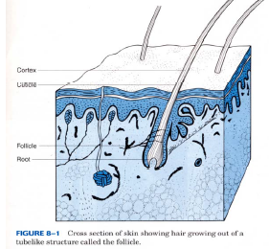
Characteristics of hair
Hair extends from the root (bulb) embedded in the follicle, and continues into a shaft and terminates at the end

Slide 6
The Hair Shaft
The shaft is the part most observed by Forensic Scientists
It is made of three layers:
Cuticle
Medulla
Cortex

Slide 7
Hair Structure
Cuticle – outer coating composed of overlapping scales
Cortex – protein-rich structure around the medulla that contains pigment
Medulla – central core (may be absent)

Slide 8
The Cuticle

Slide 9
Hair Structure
The Cuticle
The cuticle varies in:
Its scales- How many there are per centimeter, How much they overlap, Their overall shape, and How much they protrude from the surface
Its thickness, and
Whether or not it contains pigment.

Slide 10
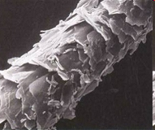
The Cuticle
Characteristics of the cuticle may be important in distinguishing between hairs of different species but are often not useful in distinguishing between different people.

Slide 11
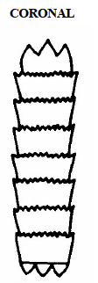
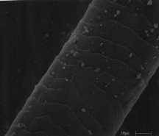
Cuticle Patterns- Coronal
Coronal (crown-like)
Scales appear like stacked cups
Example: Mouse Hair

Slide 12
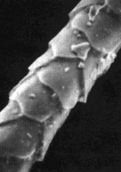
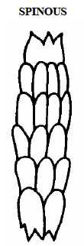
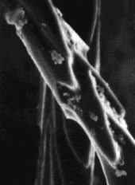
Cuticle Pattern- Spinous
Spinous (petal like)- triangular shaped scales, often protrude from the shaft)
Example: Cat Hair, rabbit hair

Slide 13
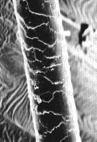
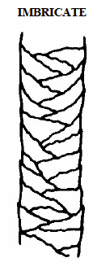
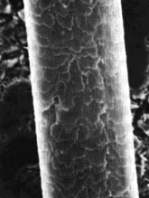
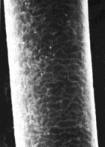
Cuticle Pattern- Imbricate
Imbricate- flattened, overlapping scales
Example: human, dog, horse

Slide 14
Cortex

Slide 15
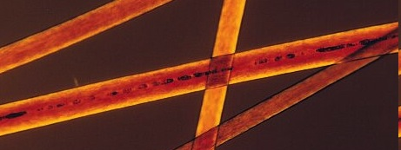
Cortex
The area between the cuticle and medulla
Varies in:
Thickness
Texture
Color

Slide 16
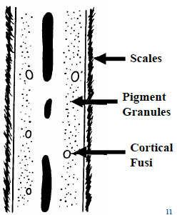
There can be air spaces (cortical fusi) and solid spheres (ovid bodies) in the cortex

Slide 17
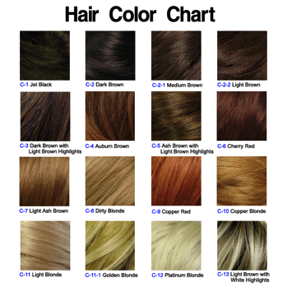
The cortex gives hair its natural color

Slide 18
Cortex:
Distribution of the cortex is perhaps the most important component in determining from which individual a human hair may have come.

Slide 19
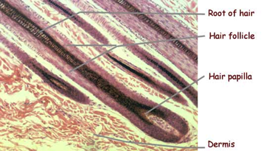
Microscopic examination can also reveal the condition and shape of the root and tip

Slide 20
Medulla

Slide 21
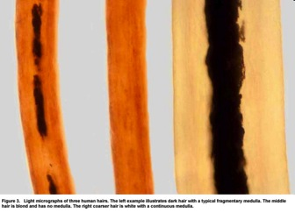
The Medulla
A collection of cells that appear to be the central canal of the hair

Slide 22
Differences in Medulla
Human Medulla:
Usually occupies 1/3 or less of the hair diameter
Animal Medulla:
Occupies ½ or MORE of the hair diameter

Slide 23
Medulla Classifications
Fragmented: small sections of irregular size
Discontinuous/Intermittent- longer segments with spaces

Slide 24
Medulla Classifications
Continuous- no breaks in the medulla
Absent: no medulla present

Slide 25
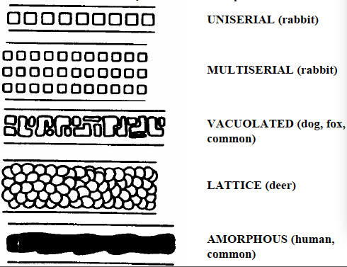
Medulla Shape
Varies from species to species

Slide 26
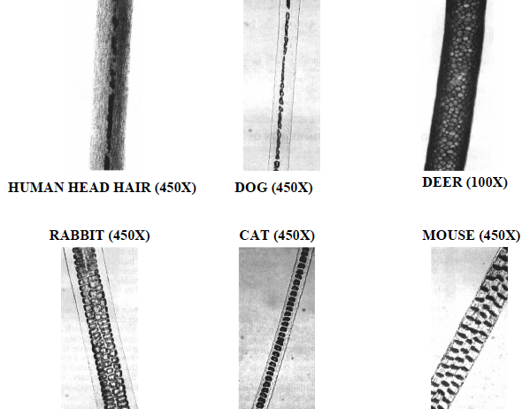

Slide 27
Special Hair Conditions

Slide 28
Dyed Hair
Often present in cuticle as well as throughout the cortex

Slide 29
Bleached Hair
Removes the pigments from the hair (yellowish tint)

Slide 30
Cut Hair
Hair grows at approximately ½ inch per month
When looking at the tip of the hair, a forensic scientist can tell if it has recently been cut (no split ends)

Slide 31
Forensic Analysis
Hair is collected and labeled for its location
Collected with:
Tweezers
Vacuum Sweepers
Lifting tape

Slide 32
Forensic Analysis
Samples from victims and suspects are taken by:
Combing and collecting loose hair
Pulling root hairs (has the follicle attached) from various parts of the body

Slide 33
Forensic Analysis
Hair can determine:
Race
If the hair fell out or was forcibly removed
Poison and drug use

Slide 34
Forensic Analysis
Hair is CLASS evidence. It cannot determine the individual
Exception: If the follicle is attached, DNA can identify the person

Slide 35
Fiber Analysis

Slide 36
Fiber Information
Fiber is often the most common type of evidence found at a crime scene
In violent crimes, fiber often plays an important role

Slide 37
Fiber is often found:
Caught in screens or on jagged surfaces
Around broken glass
On cars involved in a hit and run
Transferred during a struggle

Slide 38
Fiber Collection
It is collected in the same manner as hair
Collection is time consuming and tedious

Slide 39
Examining Fiber
Most analysis is done under the microscope
Fiber has less parts than hair but is still as valuable

Slide 40
Things to look at:
Color
Texture
Shape/pattern
Twist
Cross-section
Surface characteristics

Slide 41
Fiber Matching
Physical Matching- used when larger pieces are available and can be physically matched by site, shape, and size

Slide 42
Fiber Matching:
Micro-chemical tests- chemical reactions are used to determine the fibers’ characteristics
Micro-chemical tests destroy the fiber

Slide 43
Fiber Matching
Tests include:
Melting Point
Density
Ash Formation
Tensile Strength
Solubility

Slide 44
Types of Fiber:
Natural
Man Made

Slide 45
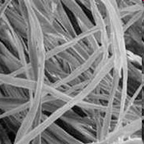
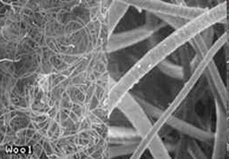
Natural Fibers
Derived (made) in whole from animal or plant sources
Examples:
Wool
Cotton
Silk
Cotton
Wool

Slide 46
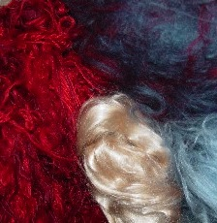
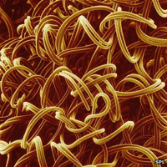
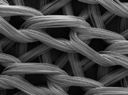
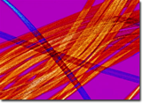
Man-Made Fibers
Synthetic Fibers- Fibers made totally from man made materials
Examples: Nylon, Polyester, Acrylic
Regenerated Fibers- Chemically altered natural materials
Example: Rayon
Nylon
Rayon

